Slide 1
Welcome
Notes:
[Please note: You may need one and a half to two hours for this presentation – to include looking at a mini Alphabetic Code Chart, taking the parents through the Activity Sheet routine – including all sections of it such as the folding-up part with the spelling-with-editing routine - and allowing time for questions at the end. Please time approximately how long your presentation will take.]
[Preparation: An Activity Sheet of your choice, a mini Alphabetic Code Chart for attendees, pencils to write with.]
If you adapt this powerpoint - or add to it, or delete some of it, please acknowledge that this is the case and that it isn’t the original powerpoint in its entirety. Thank you.

Slide 2
How did you learn to read?
Can you remember?
Notes:
Most people may say they can’t remember the details of how they learned to read!

Slide 3
Book-by-book-by-book?
Notes:
Does anyone remember ‘Janet and John’, ‘Roger Red Hat’, ‘Oxford Reading Tree’?
Children were not necessarily TAUGHT to read per se, but picked up reading book-by-book – getting through the reading scheme.
It’s not true that exposure to lots of books at home enables children to read – but it is likely to result in great language development and this is extremely important.

Slide 4
There have been many different methods of teaching reading over the years!
Notes:
Different teaching methods include: ‘look and say’, ‘real books’, ‘reading schemes’, ‘mixed methods’, ‘range of reading strategies’, ‘whole language’, ‘balanced literacy’, different approaches to ‘phonics’ teaching.
You may have heard of some of these approaches or remember them from your own school days.

Slide 5
The English language is a rich language consisting of hundreds of thousands of words
Problems arise with written language for both reading and spelling
– the influence of many languages over many years. e.g. Anglo-Saxon, West Germanic,
North Germanic, Latin, Norman French
Notes:
Problems arise not so much from the spoken language but from the written form of the English language.
The history of the English language has resulted in a complex alphabetic code for reading and for spelling.
In school, we engage the children with the fascinating history of English language development and the reason why reading and spelling is complicated.
We talk about the relationship between sounds of speech and letters being a ‘code’ for the sounds of speech.

Slide 6
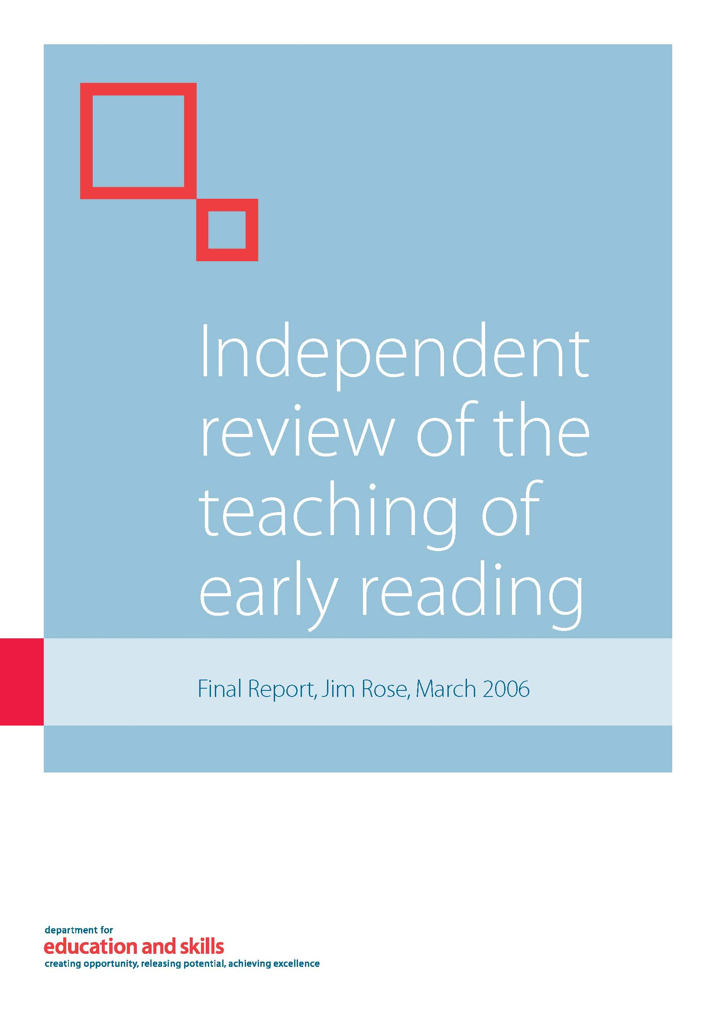
Teaching of early reading
Sir Jim Rose and his team of inspectors conducted an independent national review in 2005-6 informed by research and leading-edge practice:
Notes:
Not only did Rose and his team of inspectors pay regard to past and recent research, they valued what they saw with their own eyes in real schools.

Slide 7
The latest guidance in England:
Teachers advised to use Systematic, Synthetic Phonics programmes and ‘cumulative’ decodable reading books for beginners

Slide 8

Our school uses the
Phonics International programme
www.phonicsinternational.com
Notes:
Our school uses the Phonics International programme which is based upon the Synthetic Phonics Teaching Principles.
This teaches beginners the alphabetic code and the alphabet, and the skills of reading, spelling and handwriting and continues as a spelling programme in Key Stage Two.
Parents can hear the sounds and learn about the programme via downloadable resources and video clips at the website.

Slide 9
The Synthetic Phonics Teaching Principles
Teach:
KNOWLEDGE of the ALPHABETIC CODE
= letters linked to the sounds of speech
THREE CORE SKILLS
  ‘sounding out and blending’ for reading
  identifying sounds in words for spelling
  handwriting
Notes:
[You can expand on this: For example: Only new and unknown words need to be sounded out and blended.
Once the sounds have been identified all-through-the-spoken-word, the learner needs to select the correct letters and letter groups which are code for the sounds.
Early handwriting is taught as part of the multi-sensory approach to phonics teaching. Hear the sound, say the sound, write the letter shape or letter group.]

Slide 10
Apply:
Apply growing phonics knowledge and skills to CUMULATIVE words, sentences and texts for reading, spelling and writing
[cumulative = words which ‘match’ the alphabetic code taught to date]
Apply to reading and writing
in the rest of the curriculum
Notes:
Learners are taught at ‘word level’ at first – and then they apply their knowledge and skills to sentences and texts – and reading books which match the code knowledge taught to date.
It has been found that children make much quicker progress with decodable material at first.
[You can mention any cumulative, decodable reading books that you use in school in addition to the Phonics International programme. The PI programme has over 400 cumulative sentences and texts.]

Slide 11
More about the alphabetic code later!

Slide 12
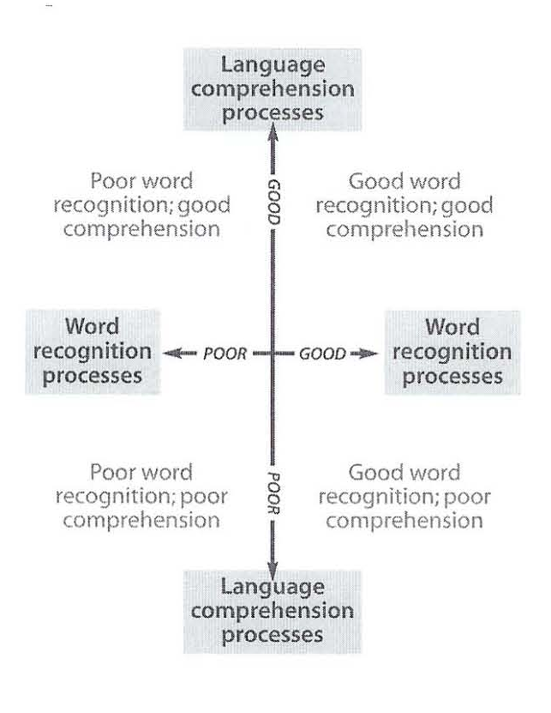
Simple View of Reading model
Gough and Tunmer
1986
What IS
the word?
What does the
word MEAN?
Notes:
Sir Jim Rose recommended in his Report that teachers adopt the Simple View of Reading model.
This is the model for understanding the main processes involved with reading.
In simple terms, this shows that we are thinking of reading as two main processes – both of which are necessary. We need to teach children how to read the words on the page, but the children need to have the general comprehension OF LANGUAGE WHEN SPOKEN to understand what the words mean.

Slide 13
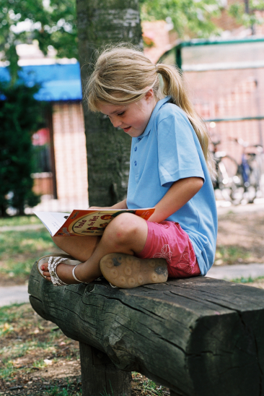
The princess wore a pale green dress.
The girl reads the words in the
book. She understands the
words automatically if she
would normally understand
them when spoken.
Notes:
The more spoken language that children know, the better - as this supports reading.

Slide 14
TALK TALK TALK
There is nothing better than...
shared sustained thinking and talking
Chatter about
anything and everything
with your children!
Notes:
This will help to build up your children’s stock of words and knowledge and understanding of the world – talk improves general comprehension and this will help the ability to read.

Slide 15


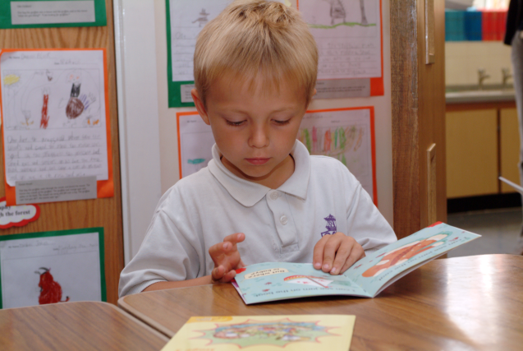
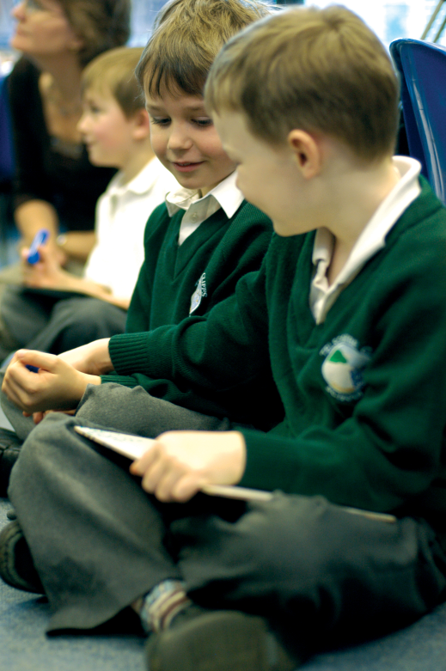

Why are books so important?
Notes:
[Ask the parents this question to draw out as many reasons as possible – ask them to ‘Talk to a partner’ and joke that this is what we do in school nowadays!:]
Thousands of new words are learned from books to expand on our daily spoken language.
For example: Creates an interest in hobbies
For entertainment and pleasure
Opens a window on the world (not just for knowledge but also concepts like empathy, understanding, intellect, morals even).
Firing up our imaginations – teachers can find the books themselves wonderfully stimulating.
In infant books, often the illustrations provide a ‘story within a story’ with sophisticated concept development.
Finding solace or expanding our minds with topics of interest.

Slide 16
Children who
read read read massively increase their vocabulary, knowledge
and understanding
Notes:
The importance of developing a reading culture both at school and in the home cannot be over-emphasised.
Find ways to encourage reading and to establish reading routines at home if possible – for example, reading at bedtime rather than watching that last TV programme!

Slide 17
The Alphabet
and
The Alphabetic Code
What is the difference ?
Notes:
We all know what we mean by ‘the alphabet’ but what do we mean by the ‘alphabetic code’?
If I asked you to write ‘The Alphabet’ you would all know exactly what I mean and it would probably take you between 12 and 15 seconds.
If I asked you to write the ‘Alphabetic Code’ you might wonder what I was talking about!

Slide 18
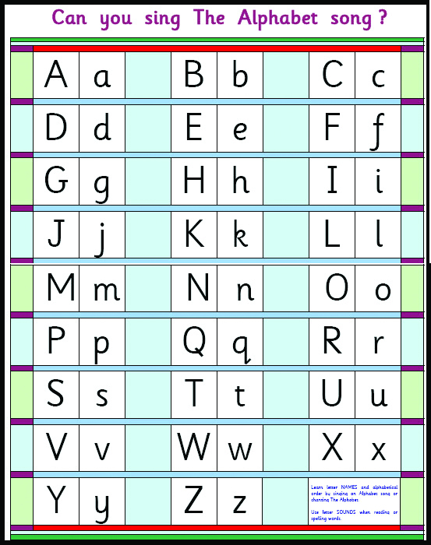
What role does the alphabet play?
1) bank of letter shapes
2) alphabetical order relayed
by letter names (ay, bee, see)
3) the capital letters are
the same code for speech
sounds as the lower case letters (/a/ /b/ /k/)
Notes:
Let’s consider how the alphabet helps learning and what we need it for...
Learn alphabetical order and letter names through singing an alphabet song.
Be aware that if children are mainly exposed to capital letters through an alphabet poster whilst saying the names of the letters, they may think of capital letters by names and not their sounds.
So, capital letters are the same code for the sounds as lower case letters. For example, /a/ (as in apple or Annie) /b/ (as in bat or Ben) /k/ (as in cat or Carla) and so on.
We can use the alphabet to say the first sounds linked to the letter shapes.

Slide 19
We don’t use
letter names
to teach reading
or spelling!
Notes:
When we teach early reading and spelling, we don’t use letter names.

Slide 20
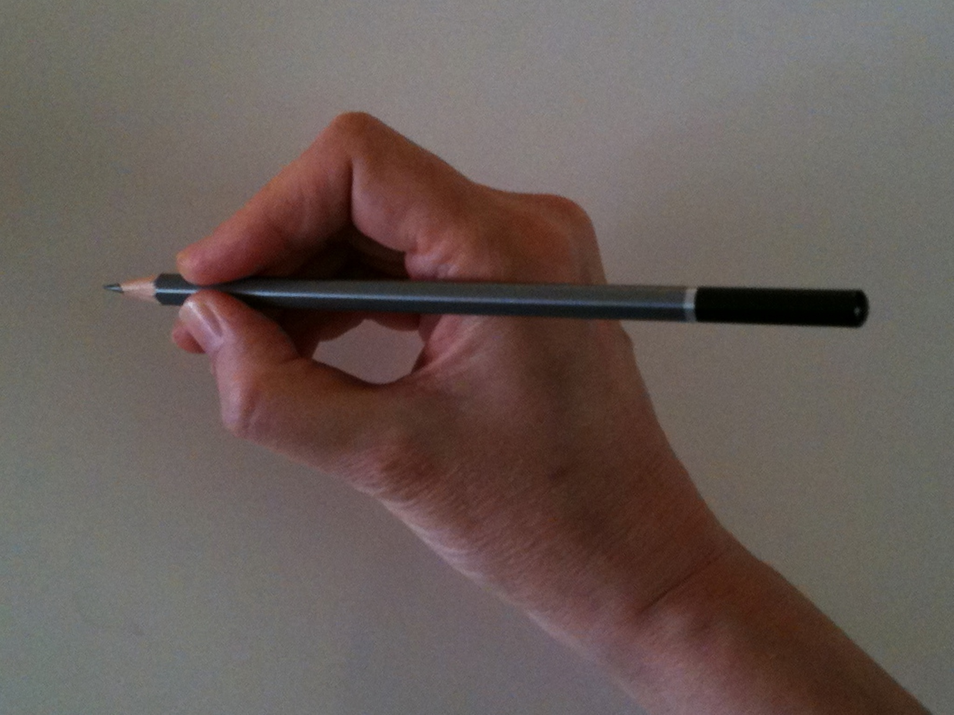
HANDWRITING
Write all the upper case (capital) and lower case letter shapes of the alphabet with the correct tripod pencil hold.
“Let me help you...”
Notes:
[Comment that many children resort to holding the pencil down the cone because they get a better grip for tiny fingers – contrary to the ‘small hands need fat pencils’ theory.
So, for learning to write letter shapes, use a normal-sized pencil.
We can model the correct pencil hold in a very kind way. “Let me help you”.

Slide 21
“Let me show you again...”
“Froggy legs with the log under”
Notes:
Child-friendly phrase, ‘Froggy legs with the log under’ or ‘sitting on a log’. Demonstrate by forming the back legs of the frog (thumb and index finger), pinch the pencil at the end of the cylinder shape (not down the cone) and place the middle finger under the pencil. This creates the tripod grip.
We can model the correct pencil hold in a very kind way. “Let me help you, I’ll show you again how to do it!.

Slide 22
What is the alphabetic code?
Letters and letter groups are code for the individual sounds in our speech.
Decoding the letter symbols into sounds is the basis for reading:
See the printed word soap, say the sounds
/s/ /oa/ /p/, blend the sounds to read (or discern) “soap”
Notes:
[Model the blending. Make sure that you say pure sounds /s/ /oa/ /p/ with no added ‘uh’ sound on the /s/ and /p/.
The more accurately the sounds are uttered, the more likely the child is to ‘discern’ the focus word.

Slide 23
Why is it ‘synthetic’ phonics?
Synthesising = sounding out and blending to read the unknown words
(aloud or silently!)
Notes:
The word ‘synthetic’ comes from the process of ‘synthesising’ which means sounding out and blending to read the word.

Slide 24
The alphabetic code is a reversible code:
For spelling/writing:
we start with sound and encode to print
For reading:
we start with print and decode to sound
Notes:
We teach that the code is reversible. The synthetic phonics teaching principles include the teaching of reading and spelling within the same lessons.

Slide 25
Phonics is not just for infants!
What do we do when we want to read an unknown Latin plant name?
What do we do when we want to spell a new multi-syllable word?
Notes:
Ask the parents to spell a multi-syllable word that you have made up.
For example, Skedringham (say it as ‘Skedringum’)
[The parents will describe that they broke it into chunks, or syllables. In other words, they used their phonics skill. They may assume it is a place name – and spell it ‘ham’ at the end, even if you pronounced it as ‘um’ at the end.]
Using phonics for reading and spelling are skills even of ADULT proficient readers and spellers.
We set children up for lifelong reading and spelling when we teach phonics rigorously.

Slide 26
We set children up for
lifelong reading and spelling when we teach phonics rigorously and comprehensively.
We are not expecting children to deduce the code for themselves like many of us had to during
our school days.

Slide 27
Teaching reading
and spelling with the complex English alphabetic code
Notes:
It is the ‘complexity’ of the English Alphabetic Code which we need to address – and how best we can teach it for reading and spelling so that no learners get left behind and all learners can reach their full potential.

Slide 28
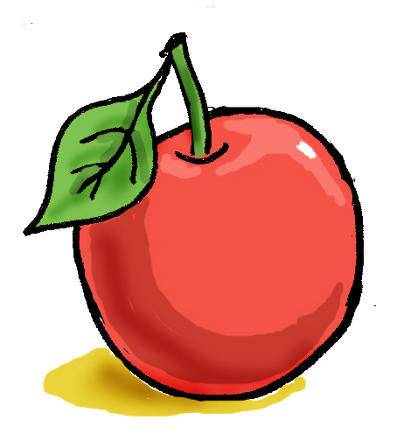
The smallest sounds
Within any spoken word, phonemes (the smallest individual sounds) can be identified.
Slash marks are used to denote the ‘sounds’.
We can hear the sound /a/ as in
We don’t use slash marks to write a word.
Notes:
A phoneme is the smallest identifiable sound in speech which changes the meaning of the word.
Thus, changing the sound /k/ in coat to the sound /b/ changes the meaning from ‘coat’ to ‘boat’.
The phonics programme shares the notion of using the slash marks to indicate the ‘sounds’ or ‘phonemes’ with everyone – the teachers, the children and the parents.
The slash marks are used on the resources. The children need to be told that these are not letter shapes, that they are slash marks and we use them when we mean the sound, not the letters.

Slide 29
There are about 44 phonemes in the English spoken language but only 26 letters of the alphabet.
We have not only single letters but also many letter groups as the written code for the speech sounds:
Graphemes = letters or letter groups:
t b a e sh ee ng igh ch ay
Graphemes are the ‘spelling alternatives’
Notes:
[Say the sounds for the graphemes on the slide – but make the point about not adding the schwa ‘uh’ effect – e.g. ‘t’ not ‘tuh’.]

Slide 30
For beginners, we teach the letters and sounds of the alphabetic code in a ‘simple’ way at first...
We teach all the sounds and at least one way of spelling them: e.g. /ee/ ee
Then we continue to teach further spelling alternatives which are code for the sounds:
e.g. /ee/ ee ea e e-e
Notes:
[Point out to the parents that the letters in the slash marks denoting the sound stay the same – but the spellings alter.
Let them study their mini alphabetic code chart if you have supplied one.]
[In Phonics International, we teach some spelling alternatives early in the programme – before all the sounds are taught. Be ready to acknowledge this if questioned.]

Slide 31
Pronunciation alternatives
Some graphemes need to be decoded with different sounds dependent on the actual word. Thus graphemes sometimes have pronunciation alternatives:
e.g. Letter ‘a’ can be pronounced:
/a/ as in apple /ai/ as in angel
/ar/ as in father /o/ as in want
Notes:
No wonder so many children have struggled to learn to read!
Spanish children do not have to contend with this complexity.
[There are further spelling alternatives such as /e/ as in ‘any’ and ‘many’ and schwa /u/ in ‘about’ but four examples is enough to take on board at this stage!]

Slide 32
Modifying the pronunciation
The pronunciation of blended sounds often needs to be ‘tweaked’ or ‘modified’ to achieve the real word:
See the printed word cheese
Recognise the graphemes ch ee se
At first, utter /ch/ /ee/ /s/
which leads to “chees”
Modify the pronunciation to “cheez”
Notes:
The need to tweak or modify the pronunciation of blended words is quite a common feature – especially with many words ending with the letter ‘s’ such as ‘pies’ and ‘peas’. Children then need to learn that these words are not spelt with the letter ‘z’ at the end!

Slide 33
We aim to create
fearless and flexible
readers and writers !

Slide 34
We encourage children to want to be accurate but not to be afraid to make mistakes.
“That’s an interesting word, let me help you to spell that. Which sounds can you hear in the word? We need this spelling alternative for that word. Here are some more words that are spelt that way.”
Notes:
We constantly support and teach spelling throughout the curriculum supported by Alphabetic Code Charts in every classroom.

Slide 35
In summary,
there are three complexities to the
English alphabetic code:

Slide 36
The three complexities of the alphabetic code:
One sound can be represented by one, two, three or four letters.
One sound can have many spelling alternatives.
One grapheme (letter or letter group) can be code for different sounds.
(That is, can be pronounced differently!)

Slide 37
Examples of three complexities:
One sound can be represented by one, two, three or four letters;
e.g. bat sheep hair eight
One sound can be represented by more than one spelling alternative, sometimes many!
e.g. The sound /or/ can be written as: or, aw, our, au, al, oar, oor, ore, augh, ough, (w)ar, (qu)ar, (w)a
One grapheme (letter or letter group) can have different pronunciations;
e.g. ‘ea’ eat, bread, break
‘ear’ fear, bear, earth, heart

Slide 38
Compare our complex English alphabetic code with some languages which have much simpler alphabetic codes:
e.g. Spanish has half the number of speech sounds (around 23+) and words are spelt with mainly
one-to-one mapping!
Many people in English-speaking countries struggle with reading and spelling because the English alphabetic code is so complex.
Notes:
Children with different mother tongues may not have the same sounds in their language, such as Spanish, and the Alphabetic Code Chart can be an invaluable aid to make the English sounds explicit and memorable.
The children need to be able to articulate all the sounds. Phonics teaching helps with this.

Slide 39
From simple to complex ...
The planned, systematic synthetic phonics programme generally teaches the code from simple to complex:
simple code ( basic, transparent )
complex code ( extended, opaque )
Notes:
[Point out that there is different terminology for describing the simple alphabetic code and the complex alphabetic code.]
[Point to a large version of the Alphabetic Code Chart. Point to the first spellings which are taught for the sounds. Then indicate the many spelling alternatives which are then taught later.]

Slide 40
With an Alphabetic Code Chart:
Simple and complex code knowledge
can be taught
at any time,
to anyone,
as required!
Notes:
http://www.phonicsinternational.com/Debbies_Phonics_Teaching_Tips.pdf
[For a true anecdote of teaching a child both the simple and complex code in one teaching session even in Reception, look for the ‘Alice’ story on the Teaching Tips pdf – link above.]

Slide 41
Let’s see how many
vowel sounds and consonant sounds we can identify in the
English language...
How many vowels do you think there are?
Notes:
[Ask the parents, ‘How many vowels are there?
It would be common for parents to say ‘five’ thinking about vowel letters in the alphabet.]

Slide 42
The ‘volume’ in spoken words is provided by the 20 or so vowel phonemes some of which we combine to make further units of sounds:
/a/ /e/ /i/ /o/ /u/ /ai/ /ee/ /igh/ /oa/
short /oo/ long /oo/ /ar/ /or/ /ur/ /air/ /eer/ /i-ee/ (as in ‘sunny’) /oi/ /ou/ /oor/
/y+oo/ /y+oor/ combined sounds
Notes:
This is a good time to ‘say all the sounds’ along with the members of staff in the school – to model the sounds for the parents.
Remind the parents that they can hear the sounds via the www.phonicsinternational.com website.

Slide 43
There are around 24 consonant phonemes – some of which we combine to make further units of sound:
/s/ /t/ /p/ /n/ /k/ /h/ /r/ /m/ /d/ /g/ /l/ /f/ /b/ /j/ /y/ /w/ /z/ /ng/ /v/ /ch/ /sh/
voiced /th/ unvoiced /th/ /zh/
/k+s/ /g+z/ /u+l/ /ng+k/
/k+w/ /ch+u/ combined sounds
Notes:
[Continue to say these sounds noting how quiet they are in comparison to the vowel sounds.]
With ‘combined sounds’, there are around 50 units of sound to be taught – not 44.
[Make sure that staff members do not add the ‘schwa’ ‘uh’ when saying the consonant sounds e.g. ‘suh’ instead of /s/ and ‘kuh’ instead of /k/ and so on.]

Slide 44
Let’s orally segment the word ‘soap’
Listen for the difference in the individual sounds
(‘left hand, palm facing’, say ‘soap’ slowly)
2. Think about your mouth movements
3. Compare the consonant sounds with the vowel sounds! /s/ /oa/ /p/
Notes:
Which sounds provide the VOLUME in spoken words? Orally segment ‘soap’ together by saying the word very slowly to identify the volume.
[Say the sounds. Repeat the exercise with discrete sounds. Note the contrast in the sounds, note the mouth movements.]
This is a dramatic example to compare the quiet consonant sounds and the loud, low vowel sound in the middle.
We tell children to notice what their teeth, mouth, tongue, jaw does when saying the different sounds. Phonics teaching and learning is excellent for children with speech and language difficulties. We need to be mindful of children who may not hear well – including when they have colds or when there are noisy distractions. Some children may not hear the very high sounds or the very low sounds because of partial hearing.

Slide 45
Oral blending and oral segmenting
1. Sub-skill of reading without letters:
Say, “Pull up the /z//i//p/ of your /k//oa//t/.”
2. Sub-skill of spelling without letters:
“Mat, /m/ /a/ /t/. Spoon /s/ /p/ /oo/ /n/.”
This helps your child’s awareness of sounds.
Notes:
Parents can help to train children in their awareness of sounds of speech.
Make up games where you are training your child’s ‘ear’ to discern the words from blending the separate sounds – and to break up the words into their constituent sounds.
Notice that, for the reading sub-skill, you start with the separate sounds of the words then say the whole word (your child can start to discern the whole word).
For the spelling sub-skill, you say the whole word first followed by saying the separate sounds and eventually the child will be able to do this.

Slide 46
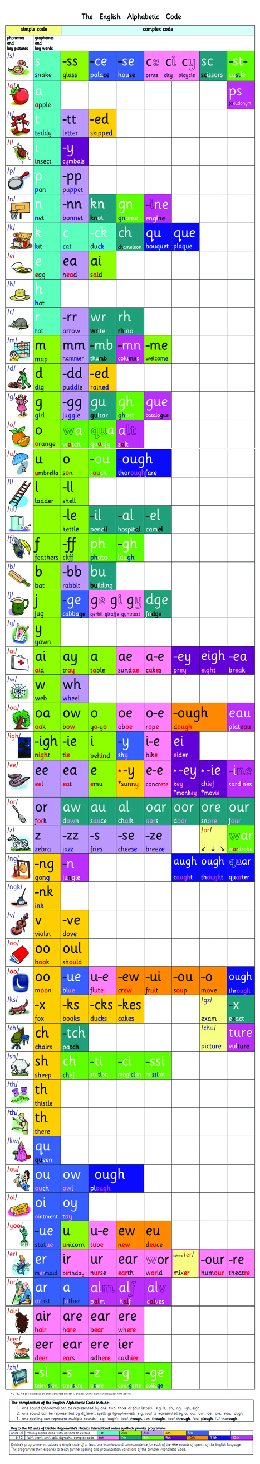
Phonics International
Alphabetic Code Chart
Spellings are
shown across
the rows
Sounds are
shown down
the left column
Notes:
On the alphabetic code chart, we see the sounds shown down the columns; and the letters and letter groups which are code for the sounds are shown across the rows.
[Provide the attending parents with mini Alphabetic Code Charts if possible to look at during the session.]
[Please note, some parents may express concern that the chart is ‘too much’ for four to five year olds. Reassure them that the children are being taught their phonics in tiny systematic steps and the chart supports the adults at this point and the children begin to absorb and assimilate the rationale over time. Some children, however, can even ‘self teach’ from the chart.]
[There are simpler charts in the Early Years Starter Package.]

Slide 47

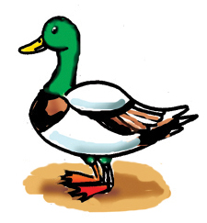
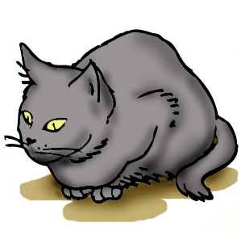
Aids to Memory
/k/
c a t k i t d u ck
Pictures and words makes the learning of the different sounds and spellings memorable and manageable.
Notes:
This system supports the teaching and learning of both the sounds and the spelling alternatives – so it is sustained throughout the whole programme.
The teaching and learning becomes ‘memorable’ and ‘manageable’.

Slide 48
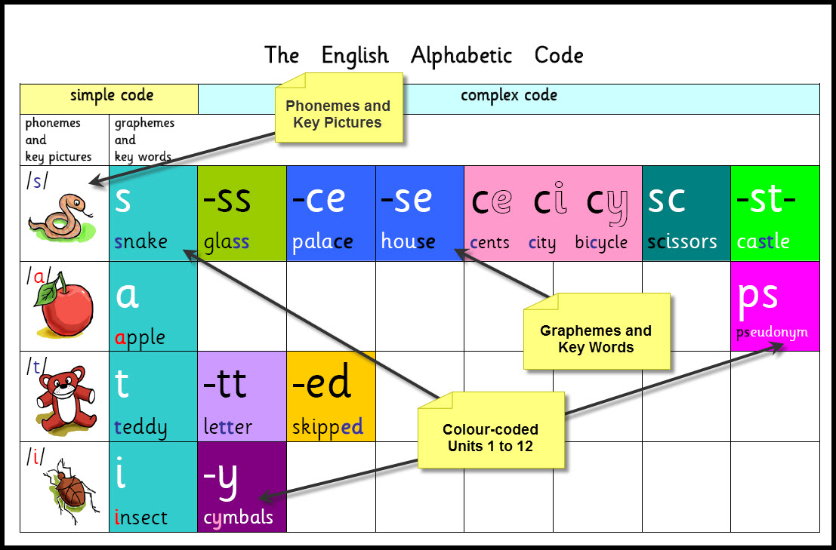
Phonics International
Alphabetic Code Chart
Notes:
This alphabetic code chart is colour-coded according to the order of introducing the letter/s-sound correspondences.

Slide 49
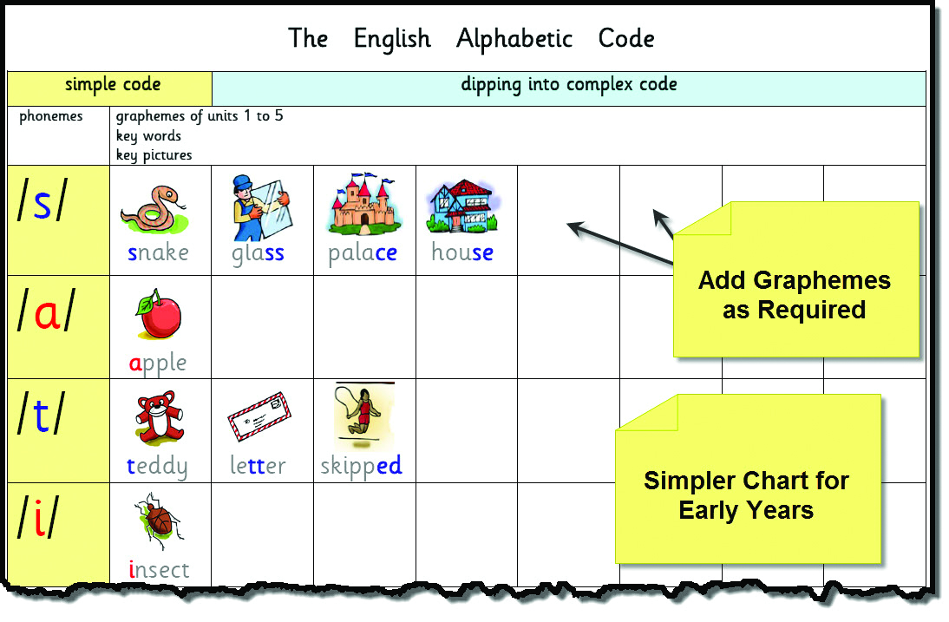
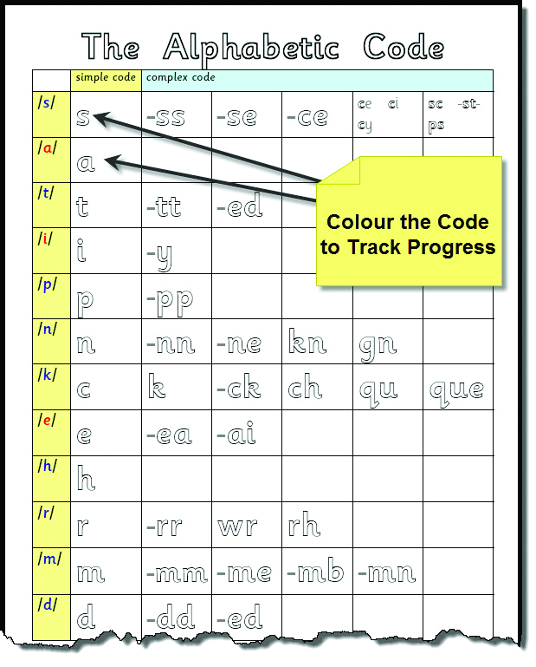
Choices of Alphabetic Code Charts
Notes:
In the Phonics International programme, there are many styles of Alphabetic Code Charts so that we can choose the most fit-for-purpose ones for teaching and for learning.
Parents can find many types of chart in the free Unit 1 webpage via the www.phonicsinternational.com website.

Slide 50
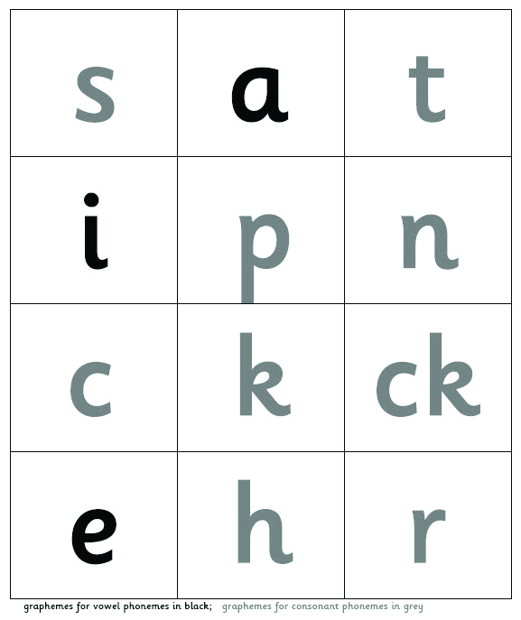
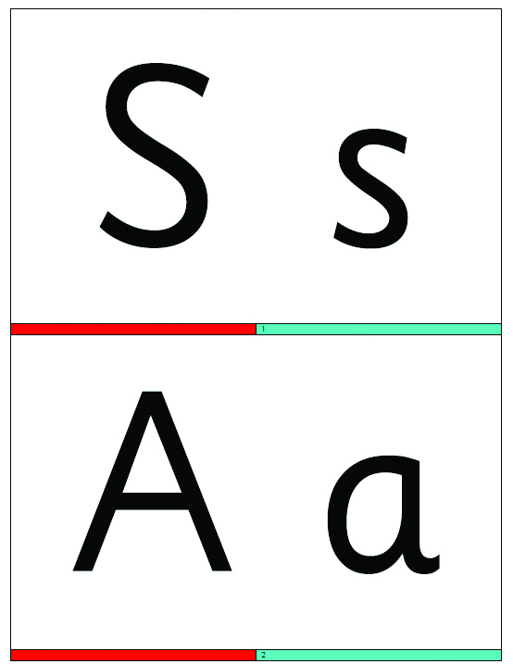
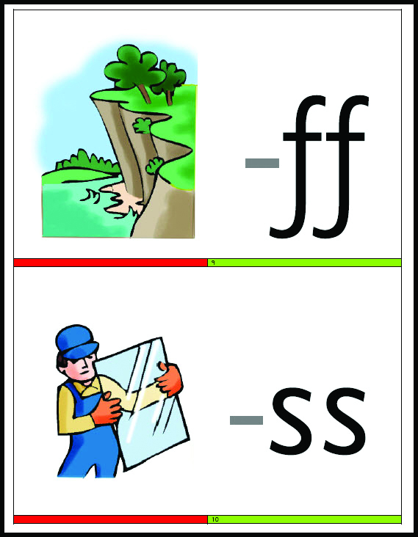
Resources to teach the alphabetic code:
Grapheme Tiles and Flash Cards
‘See the graphemes and
say the sounds’ is a
sub-skill of reading.
Notes:
Various resources support learning letter/s-sound correspondences to AUTOMATICITY.
Teachers can use some different core resources whilst the children practise the same skills.
These are further ‘sub-skills’ but this time with the letters and letter groups. Previously we focused on the sub-skills for developing an awareness of the sounds without the letter shapes.

Slide 51
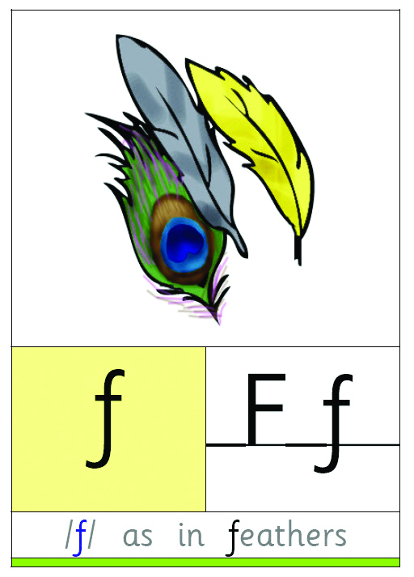
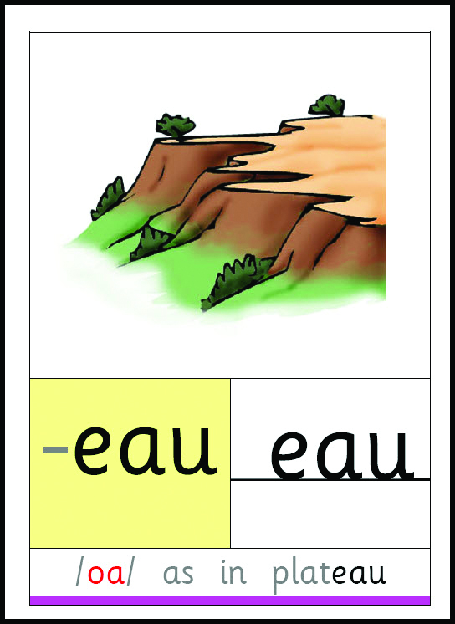
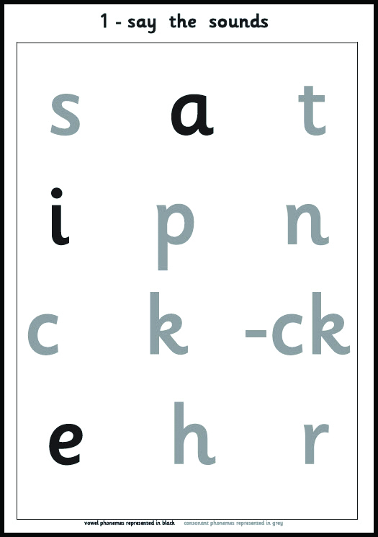
‘Say the Sounds’ Posters and Frieze
‘Hear the sounds and
point to the graphemes’
is a sub-skill of spelling.
Notes:
All of these resources support learning letter/s-sound correspondences to AUTOMATICITY...
Remember - From print to sound for reading – from sound to print for spelling.
[Tell the audience: Point to the /s/. Point to the /t/. Now point to the /k/. They’ll need to say ‘which one?’. Point to the /k/ as in ‘kit’ – point to the /k/ as in ‘duck’ – point to the /k/ as in ‘cat’ – This is one reason why we need key words to root the sounds and spelling alternatives.]
When the Say the Sounds poster comes home in the bookbag, the sounds can be practised at home.

Slide 52
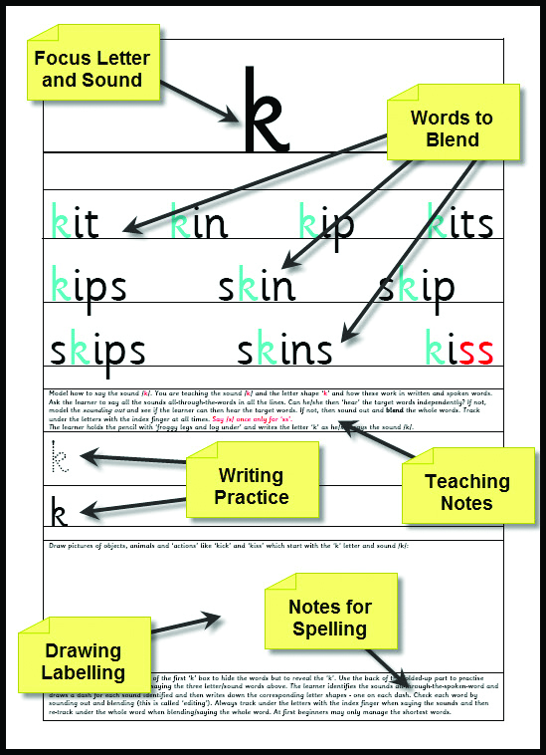
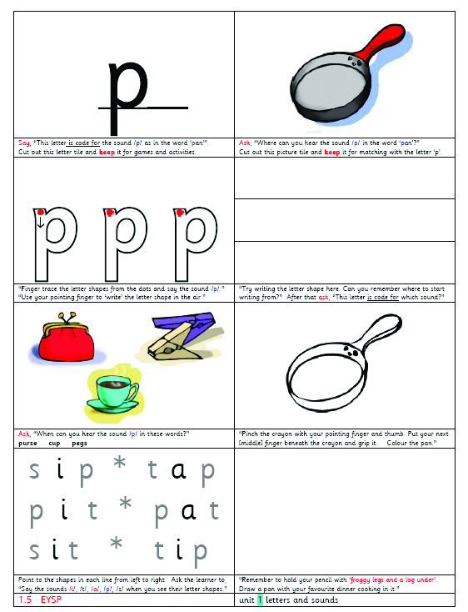
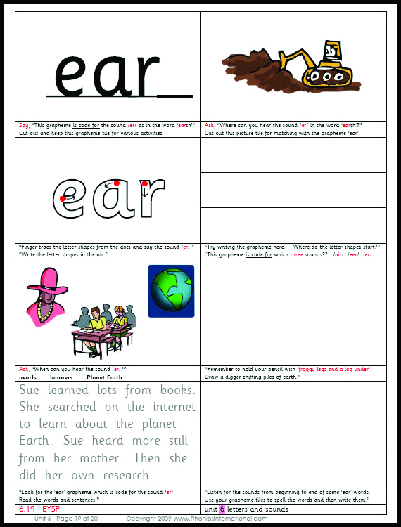
ESSENTIAL MULTI-SKILLS ACTIVITY SHEETS
Individual practice of the
sub-skills and core skills
for reading, spelling
and handwriting
Notes:
[Provide the parents with an Activity Sheet each and a pencil if possible, and take them through the way the children use them in school. Point out how very ‘core’ and effective these skills’ activities are. Model the finger-tracing for the letter shape whilst saying the sound. Model the finger tracking under the graphemes for sounding out and blending. Model the tallying sounds to thumb and fingers of the left hand, palm facing, for the spelling routine. Count the sounds, write sound dashes on the back of the folded-up part of the Activity Sheet, and say the sounds whilst handwriting the graphemes from left to right. Finish by finger tracking under the graphemes from left to right whilst saying the sounds and blending the word. Is it correct? If so, tick the word.]

Slide 53
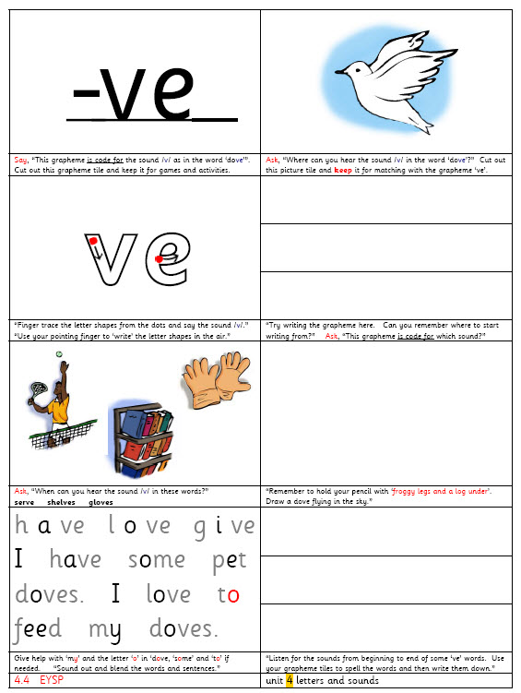
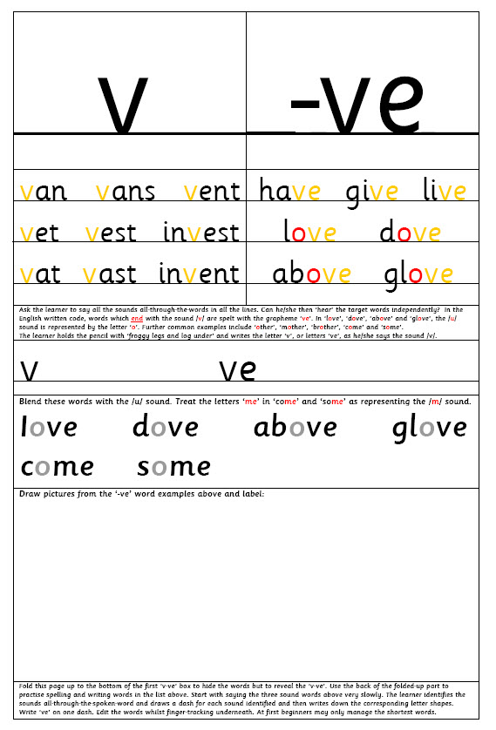
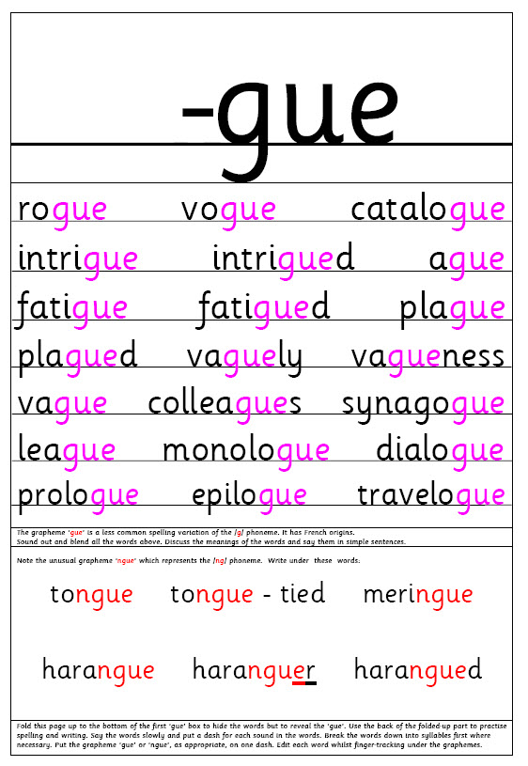
Always – ‘fold up’ for the spelling routine!
Generally - alternate the Activity Sheets with
cumulative sentences or texts as appropriate
Notes:
Core VAK Activity Sheet – VERY fit for purpose. These develop cumulatively throughout the whole programme. Once children can read, they are continued to support spelling.
The alphabetic code knowledge is included on the Activity Sheets for the supporting adult and to inform the parents.

Slide 54
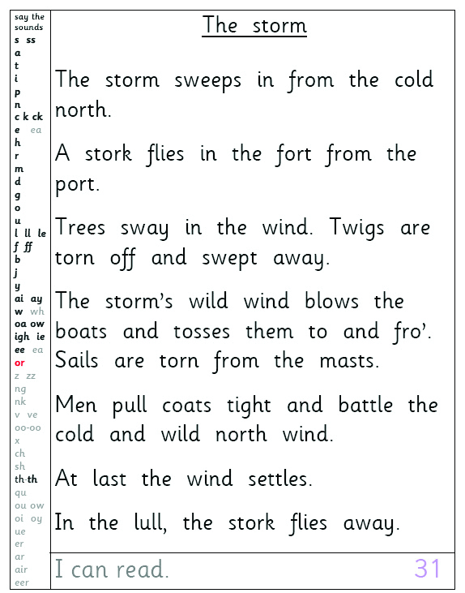
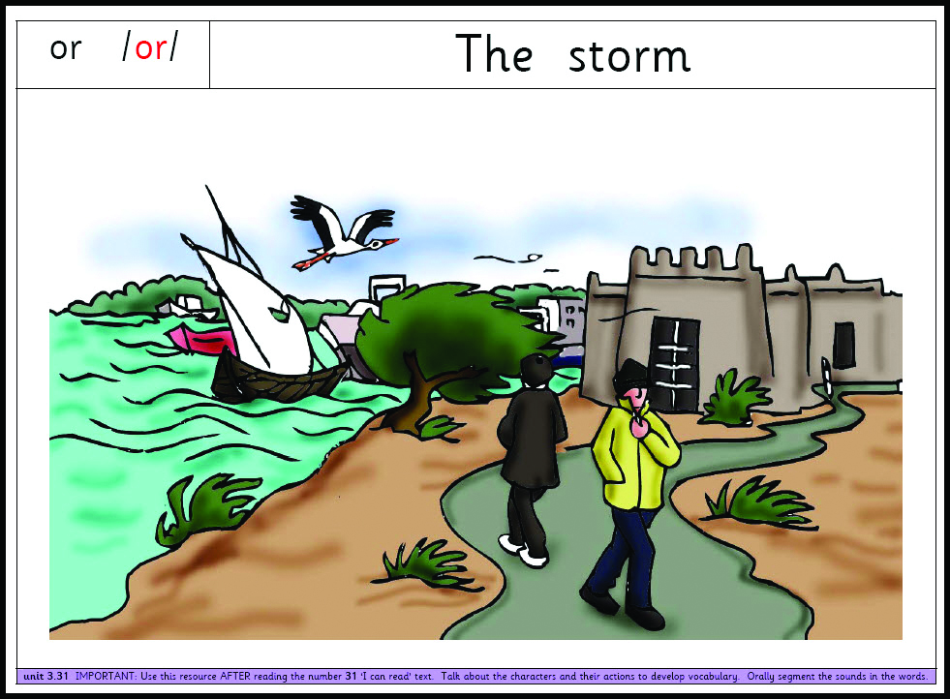
Simple, but powerful, multi-purpose CUMULATIVE TEXTS
Work at own speed:
Grapheme search
Decode
Comprehend
Self-dictation
Convert to joined writing
Write extension sentence
Illustrate
Periodic teacher dictation
Accelerate learning!
Notes:
There are cumulative sentences and texts throughout the Phonics International programme.
These are invaluable and can accelerate learning.

Slide 55
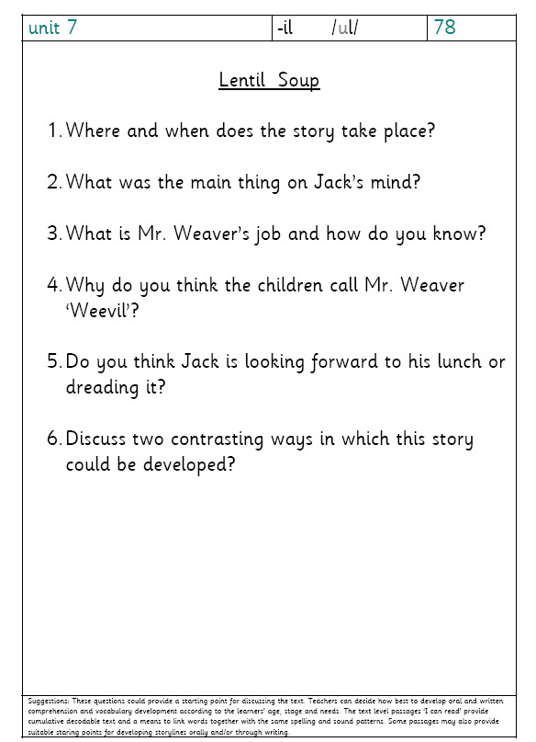
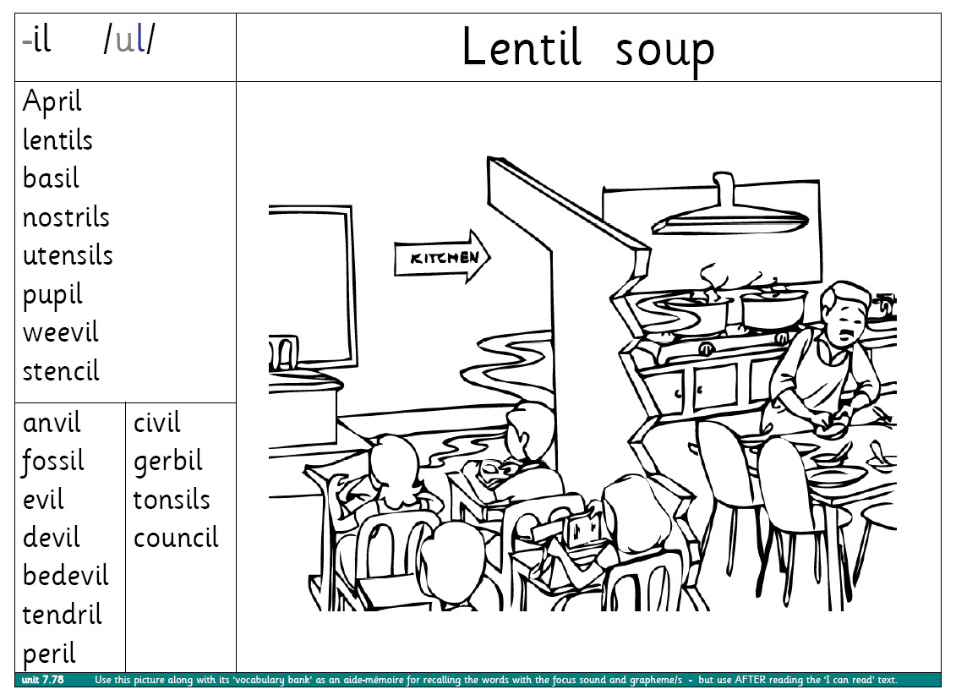
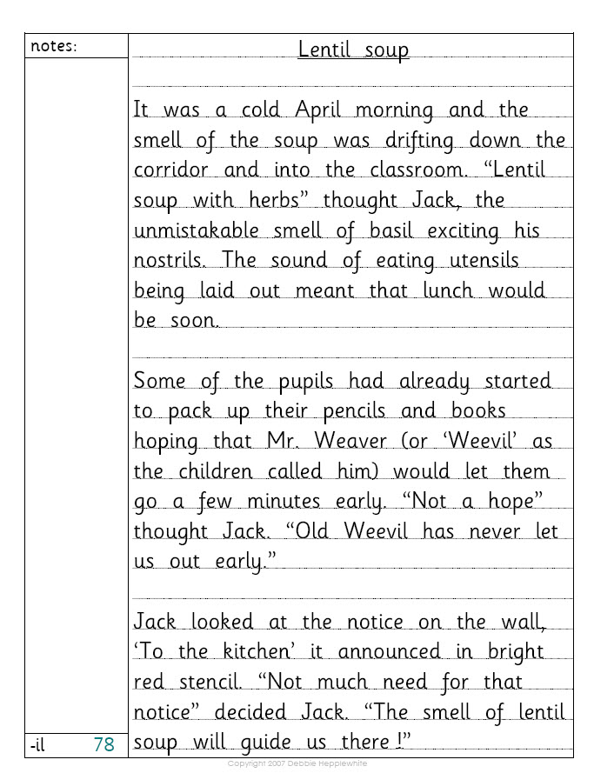
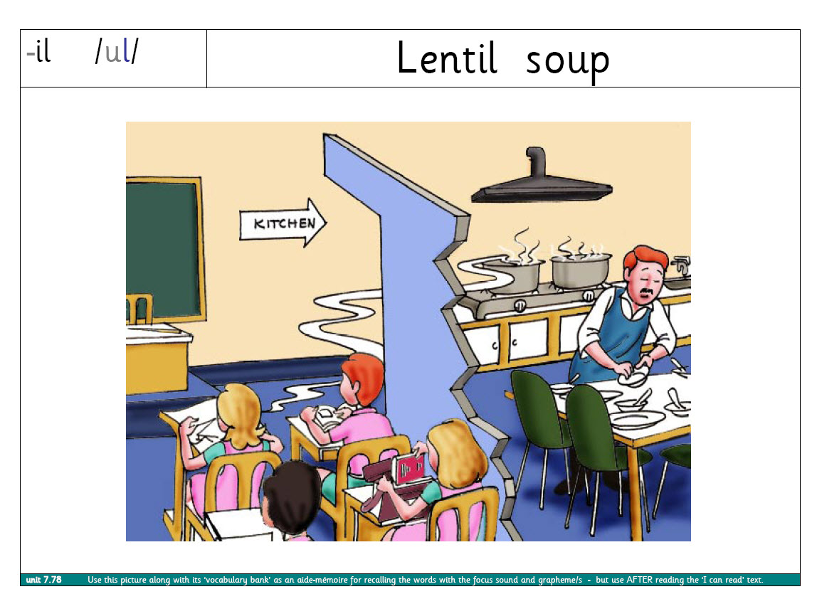
Spelling Story Themes and Pictures
aid memory for recalling spelling word banks
Notes:
Here we have a great example of how the phonics teaching for both reading and spelling can be linked with the spoken language, comprehension and story themes.
Ultimately, for spelling many words, the learners need to recall spelling word banks stored permanently in memory such as the ‘il’ words above. A story theme and picture, comprehension questions, and even ‘acting out’ the words, can help children to recall spelling word banks.

Slide 56
The school’s bookbag routine
The Activity Sheets and
Cumulative Texts and
Say the Sounds Posters
are collected in a clip folder
for the bookbag routine!
Parents can then see some
of the phonics work that
takes place in school.
Notes:
Please take an interest in your child’s phonics work. It may be helpful to practise some of it again at home as ‘little and often’ learning helps children to remember.
Give your child plenty of praise for his or her work whatever the level of the knowledge and skill of the child.
If you have any worries about the phonics work, or any questions, please don’t hesitate to contact your child’s teacher.
You can always communicate through your child’s READING RECORD BOOK which is also kept in the bookbag.

Slide 57
Differentiation
Learners access core resources differently – at their own stage of learning and speed
Every learner undertakes his or her own practice
Notes:
Let’s clarify the methods of differentiation when each learner has the same Activity Sheet and Cumulative Text.
We would really appreciate if you could take an interest in the phonics work coming home in the bookbag.

Slide 58

Extension activities are always provided
Different levels of support
Some learners may require additional time

Slide 59

How the adult supports the learner to read is very important...
Tell the learner the code:
straight In this word, these letters
are code for /ai/.
Notes:
Children will need different levels of support when reading aloud.
There are different ways that the adult can help the learner to read the words.

Slide 60
2. Alternatively, model the sounding out and blending of the word to the learner.
3. Or simply tell the learner the words which are proving too difficult.

Slide 61
‘Tricky Words’
Such words are introduced steadily throughout systematic synthetic phonics programmes.
It is better to tell the learner a really challenging word, than to tell the learner to ‘guess’ the word.
Notes:
Encourage your child to blend and allow time for this.
If you are not feeling confident about supporting the reading in a code-based way, then tell your child the tricky words when he or she is ‘stuck’.
[You may wish to mention and/or show any cumulative, decodable reading books which you use in schools for home-reading or reading in school.]

Slide 62
And always the adult should discuss the content of the book with the child!

Slide 63
PLEASE:
Listen to your child read to you and support as needed (AND talk about the story)
Read books aloud to your child
Share the reading of books with your child
Continue to hear your child read aloud even when he or she can read independently
Chatter about everything!
Notes:
We cannot overemphasise the importance of your child continuing to read aloud and the importance of masses of talking taking place at home.

Slide 64

Over 250 FREE e-books
Notes:
There are masses of fantastic books, complete with narration, online at the Oxford Owl website.
[And remember that you can hear the sounds and see their spelling alternatives at www.phonicsinternational.com .]

Slide 65
Library
Notes:
[Describe your school and local library provision – and ask parents to consider starting a Book Club or supporting with the school’s library and so on. Personalise this to your own circumstances.]

Slide 66
Thank you for coming!
Please do approach us if you have any worries about your child’s progress.
Notes:
Remember that you do not have to worry about your own understanding of phonics as we introduce the alphabetic code to your children in little bite-sized steps.
All will become clear as the school’s phonics programme progresses and you can even learn more about the alphabetic code alongside your child!

